Slide 1
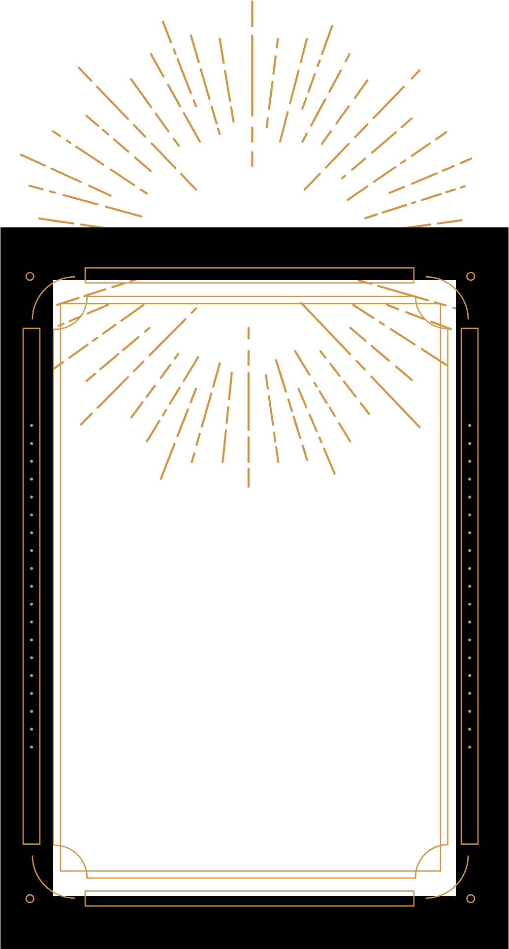
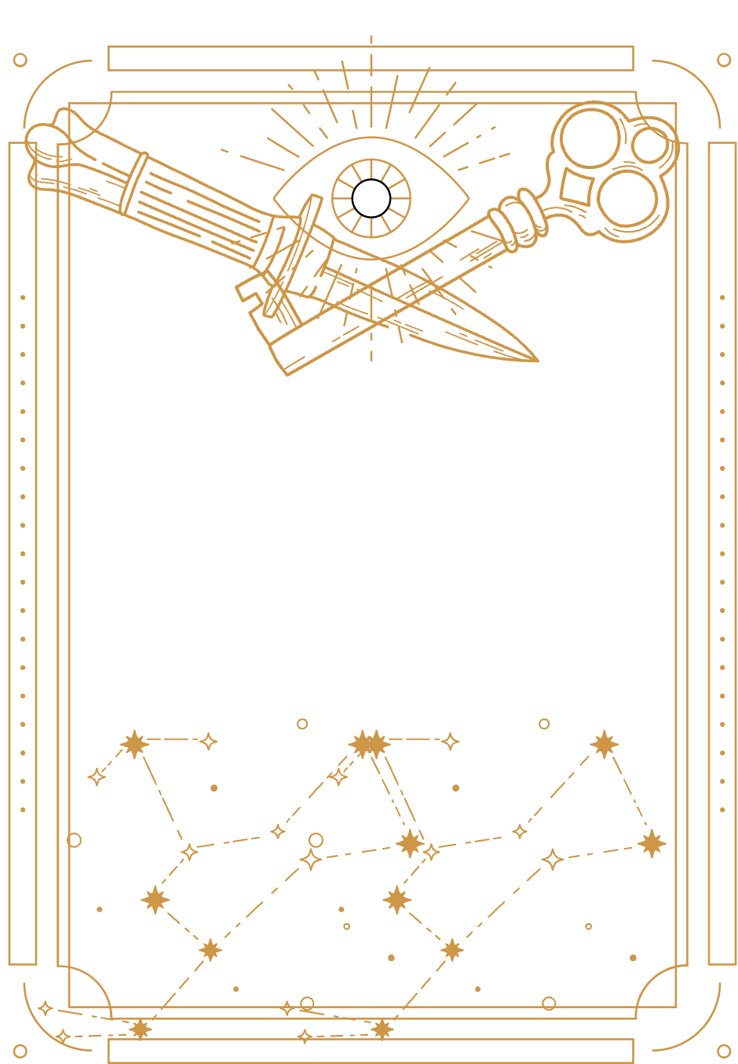
Black Magic Love Spell: Unlocking The Mysteries Of Passion And Desire

Slide 2

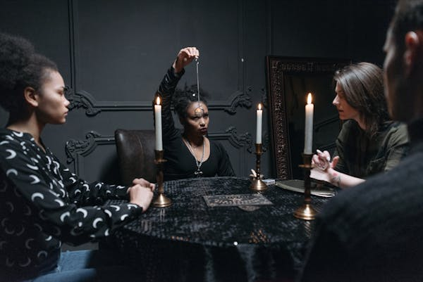
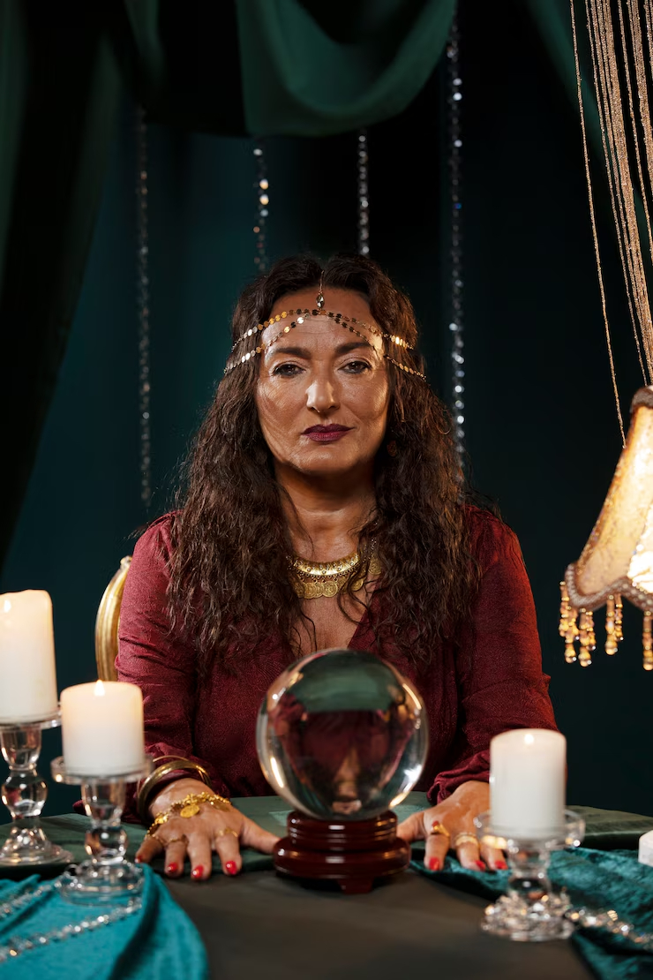
Black magic love spell are among the most intriguing practices in the realm of modern witchcraft. Known for their intensity and swift results, these spells are designed to influence emotions and relationships, making them a powerful tool for those seeking to fulfill their deepest desires. Whether it's rekindling lost love, overcoming romantic obstacles, or binding someone to you forever, black magic love spells promise transformative outcomes that are unmatched by other forms of magic.

Slide 3


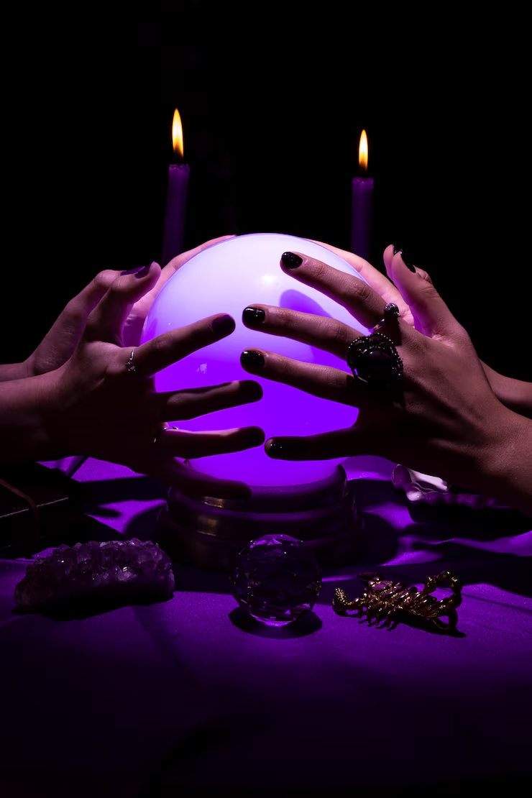




What Are Black Magic Love Spells?
Black magic love spells harness supernatural energies to manipulate emotions and relationships, often bypassing free will. Unlike white magic, which focuses on harmony and benevolence, black magic delves into the darker aspects of human emotions to achieve specific goals. These spells often involve rituals using the target name, date of birth and photograph.

Slide 4


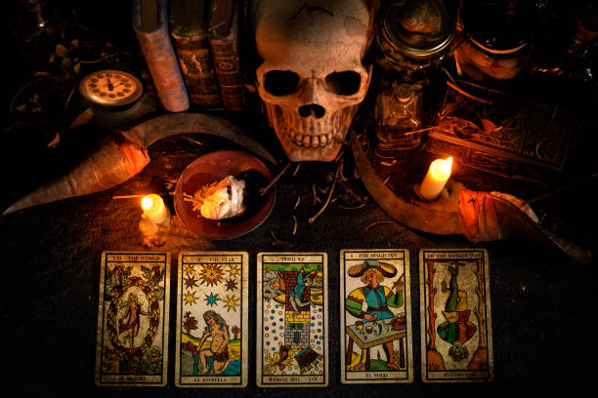

How Do They Work?
The effectiveness of black magic love spells lies in their ability to tap into universal energies and summon dark forces to manifest desires. Rituals may include chanting incantations, using voodoo dolls, or performing ceremonies during specific lunar phases for optimal results. Professional spellcasters often play a crucial role in ensuring these rituals are performed correctly. Experts at Psychic Rituals provide guidance and safeguard clients from potential negative repercussions.

Slide 5



Benefits of Black Magic Love Spells
● Rapid Results: It’s renowned for its swift manifestation, making it ideal for
urgent matters of the heart.
● Overcoming Obstacles: These spells are particularly effective in breaking
through barriers such as rival influences or emotional resistance.
● Binding Power: Black magic can create unbreakable bonds between
individuals, ensuring lifelong commitment.
● Overcoming Obstacles: These spells are particularly effective in breaking ● Binding Power: Black magic can create unbreakable bonds between individuals, ensuring lifelong commitment.througarriech as rival influences or emotional resistance.

Slide 6
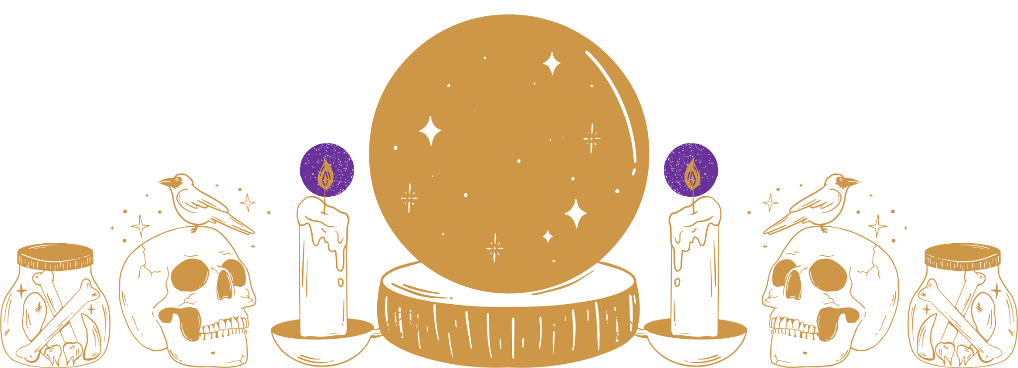
Regardless of your location, religion, or sexual orientation, you can entrust your magical work inquiries with assurance of honesty and confidentiality to your chosen mystic on our platform. In conclusion, black magic love spell offer a potent means of achieving romantic desires but require expertise and responsibility. For those ready to explore this mysterious art, consulting a professional spellcaster ensures safety and success in navigating the complexities of love magic.

Slide 7



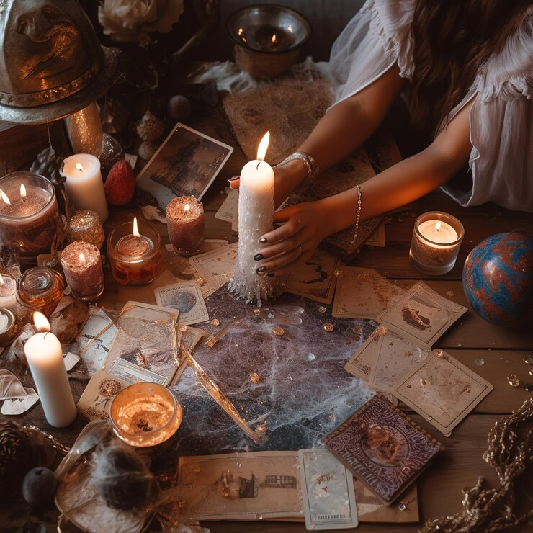
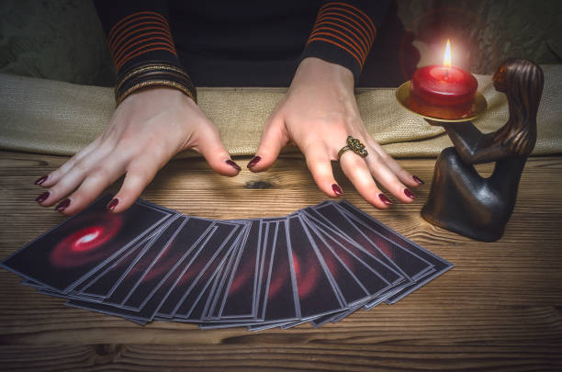
Struggling with love problems? Feeling lost and heartbroken? Trust us to help guide, heal, and transform your life.

Slide 8

Contact Us
ADDRESS :-
1007 N Osceola Ave Clearwater, FL 33755, USA
instagram :- www.instagram.com/psychic_rituals_marketplace/p/DBx
WcgPzpvp/?img_index=1

